Slide 1
Home Illinois Workforce Pilot: Job Training and Economic Development Program
Office Of Employment and Training

Slide 2
Agenda
Welcome from Christine – overview of the need – why are we here?
Welcome from Julio – overview of the role of WIOA – call to action for LWIA’s
Overview of the program model
Small Group – Regional Discussion Questions:
Who are the people in the room
What are the outcomes we can address in our region?
How can I get involved?

Slide 3
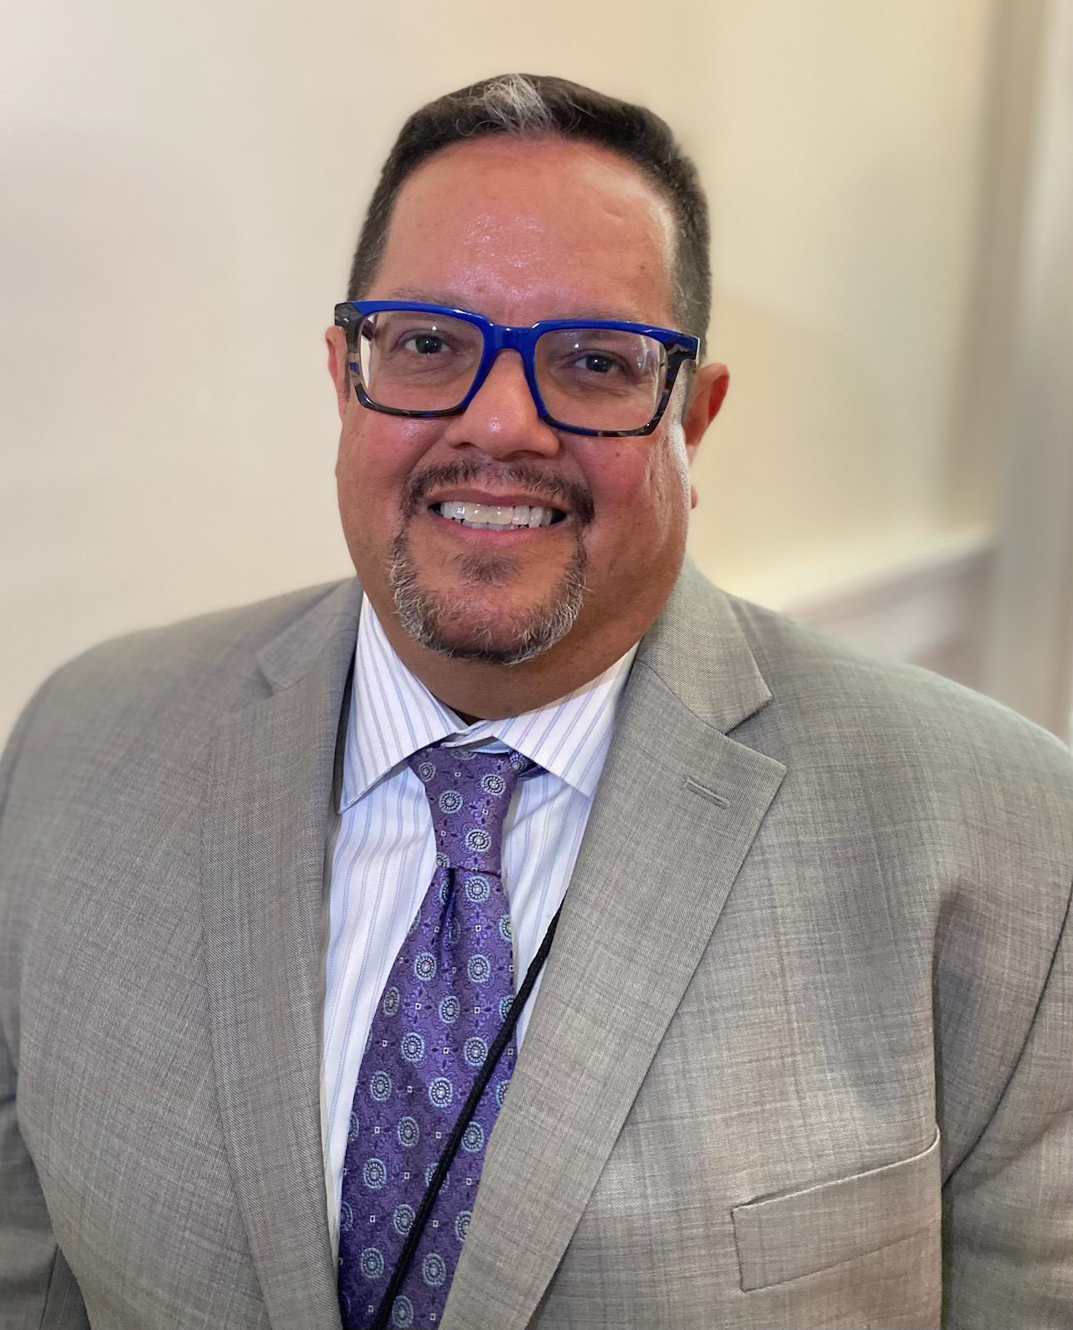
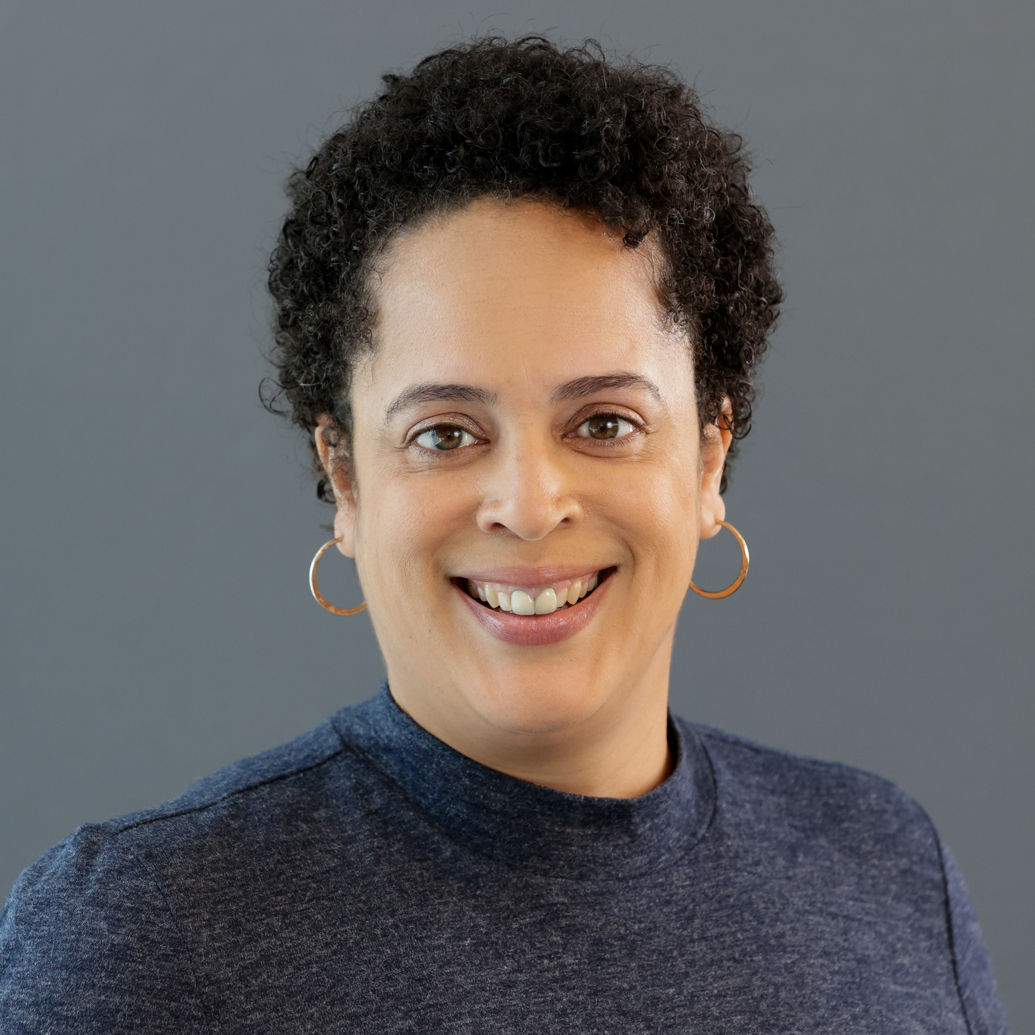
Commentators
Julio Rodriguez is the Deputy Director of the Office of Employment and Training. He has 30+ years of experience in the workforce and human services field, fostering collaboration and driving innovation in workforce development. Mr. Rodriguez has had a pivotal role in shaping state workforce development policy and programs that are recognized at the national level.
Christine Haley is the Chief of the Illinois Office to Prevent and End Homelessness. Christine works with 16 state agencies to implement a strategic plan to prevent and end homelessness for Illinois residents. Christine chairs of the Illinois Interagency Task Force on Homelessness and co-chairs the Community Advisory Council on Homelessness.

Slide 4
Overview
Through funding provided by the Illinois Job Training and Economic Development (JTED) Grant Program, The Illinois Department of Commerce and Economic Opportunity (DCEO) is partnering with the Illinois Department of Human Services (IDHS) and the Illinois Interagency Task Force on Homelessness to Prevent and End Homelessness to support strategies identified in the Home Illinois: Illinois’ Plan to Prevent and End Homelessness (The Plan).
Link: Home Illinois: Illinois’ Plan to Prevent and End Homelessness - Annual Report: July 2022-October 2022 (state.il.us).
Specifically, the NOFO will support Strategy #3 – Secure Financial Stability.
The Pilot program will be implemented in three (3) to five (5) Continuum of Care areas throughout the state that connect people who are experiencing homelessness to employment and that demonstrate systemic coordination of the homeless response system and workforce system.
The intended result of coordinating to improve employment opportunities is to improve the financial stability of individuals and their ability to afford permanent housing in their community and develop a sustainably system for delivering services.
The Illinois Job Training and Economic Development (JTED) Grant Program is funded by State of Illinois General Revenue Funds appropriated by the General Assembly in the State Fiscal Year 2024 budget. The requirements of the program follow 20 ILCS 605/605-415 (JTED Act) and the rules adopted in support of the JTED Act, 56 Ill. Admin. Code Part 2660 (JTED Rules).

Slide 5
Applicant Eligibility
Eligible Applicants:
Lead entity of the Continuum of Care Continuum of Care (COC) organizations including private nonprofit organizations (which may include a faith-based organization), and
Local Workforce Innovation Area (LWIA) organizations that administer the Federal Workforce Innovation and Opportunity Act (WIOA)
One of the partnering organization must have demonstrated expertise and effectiveness in administering workforce development programs [20 ILCS 605/605-415(b)]
Note: COC’s that are government entities are NOT eligible to be the lead applicant, The lead entity must meet the statutory definition for Eligible Entity but can partner with a CoC to run the program if the CoC doesn’t meet the definition for eligible entity.
Eligible Participants:
The JTED program regulations require that services be provided to the “target population,” defined as persons who are unemployed, under-employed, or under-represented that have one or more barriers to employment. [20 ILCS 605/605-415(b)]. This NOFO will address the needs of a specific sub-population of the JTED “target population”: Individuals experiencing homelessness who reside in shelters or who participate in a Rapid Re-housing (RRH) Program.

Slide 6
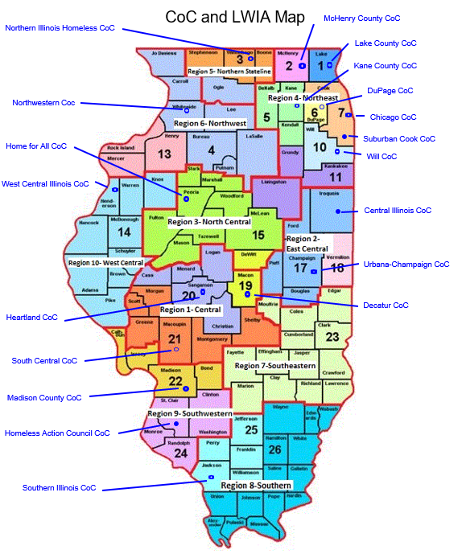
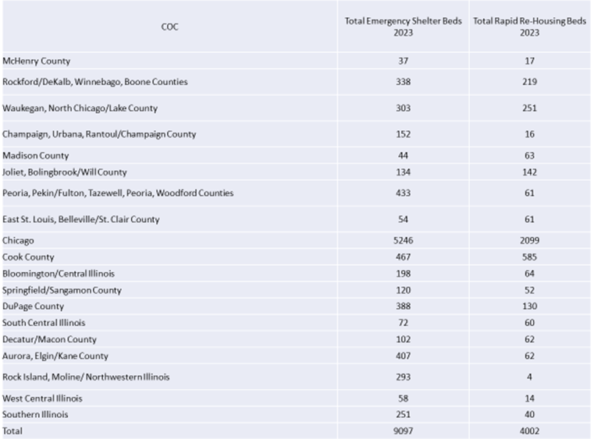
CoC and LWIA Locations and Number of Beds Shelter/RRH

Slide 7
Partnerships
At a minimum, the pilot programs must have a partnership between the lead agency of the COC in the area, the Local Workforce Innovation Area(s) ("LWIA"), and one or more organizations that operate an RRH program or shelter in the area.
This must be demonstrated through a Memorandum of Understanding (MOU) or a commitment letter that expresses the intent to develop a robust MOU during the planning period.
The MOU should identify roles and responsibilities, timelines, referral processes, reimbursement processes (if applicable), and how the entities will jointly share responsibility for the success and sustainability of the pilot program.
Partnerships should also be established with other organizations that are necessary for the success of the program, including community-based organizations that provide additional support or other services.
The NOFO includes a 6-month planning period to establish partnerships and
design the pilot.

Slide 8
Funding
Funding Source: State of Illinois General Revenue Funds
Total NOFO amount: $5,000,000
Award Range: Individual awards not to exceed $2,000,000
Number of Anticipated Awardees: 3 - 5
Matching Requirements: No matching funds required
Pre-Award Costs Allowed: Yes
Indirect Costs Allowed: Yes

Slide 9
Building Partnerships
Small Group Regional Discussions
Define Problem
Keep forefront the end results/outcomes - what are the needs of the customer
Mapping Assets
What do the partnering organizations bring to the table. This includes the organizations assets as well as existing relationships/networks assets.
Considerations:
Is there duplication or enhancement of assets? Where are the gaps in assets?
How is collaboration advantages to achieving results?
Next Steps to Developing Partnership
How can we get involved in developing this partnership

Slide 10
Report Out From Small Group Discussion
North Region
Central Region
Southern Region

Slide 11
Important Dates
NOFO Posting Date: March 14, 2024
Anticipated Award Start Date: July 1, 2024
Anticipated Award End Date: June 30, 2026
Application Technical Assistance Conference: March 26, 2024, 1:00PM Registration link : https://us02web.zoom.us/j/88310575097

Slide 12
Questions?

Slide 13
Thank you!
Tammy Stone
Tammy.Stone@illinois.gov
Shannon Hampton
Shannon.B.Hampton@illinois.gov

